Slide 1
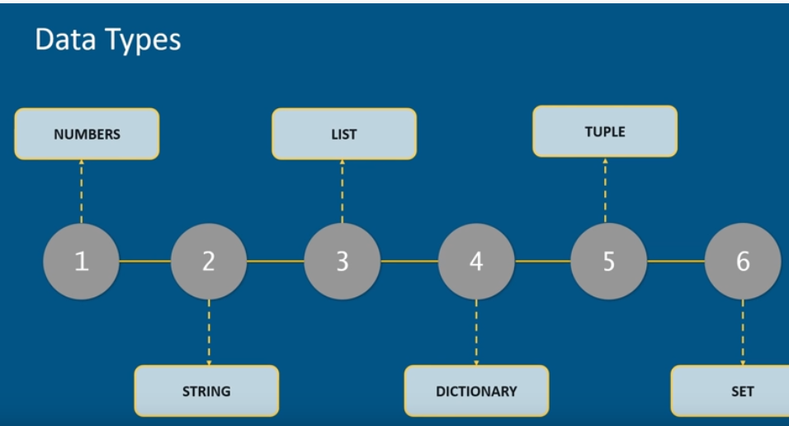

Slide 2
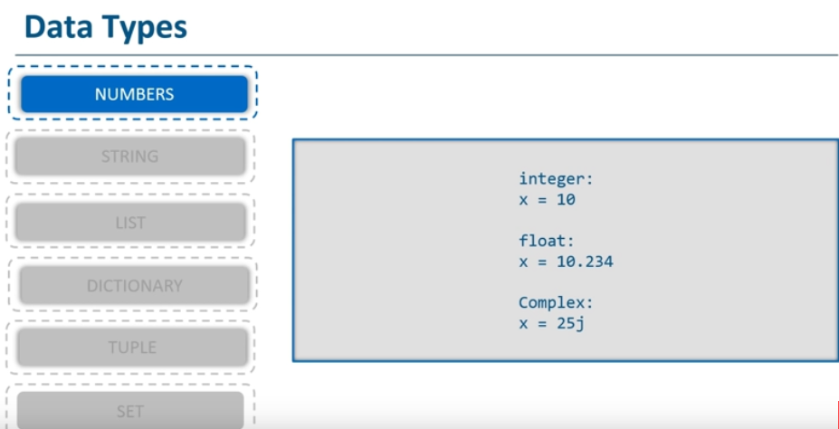

Slide 3
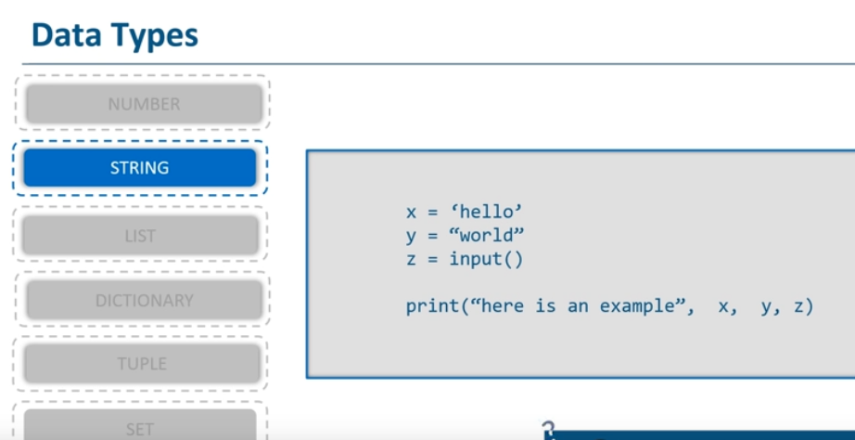

Slide 4
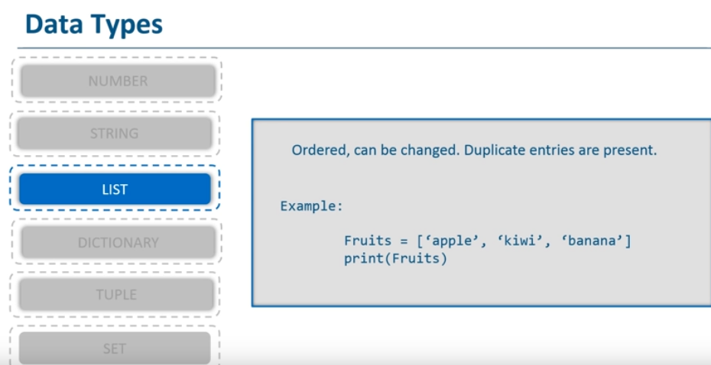

Slide 5
Lists are mutable(changeable )
Fruits = [‘apple’, ’kiwi’ , ‘banana’]
Print(Fruits)
Update
Fruits[2] = ‘Oranges’
Print(Fruits)
2. Add a value using append (adding value at the end of the list)
Fruits.append(‘Mango’)
3. Adding a value in the middle of the list (use insert function and index where you want it added)
Specify the index number then give it a value
Fruits.insert(1, ‘Kiwi’)

Slide 6
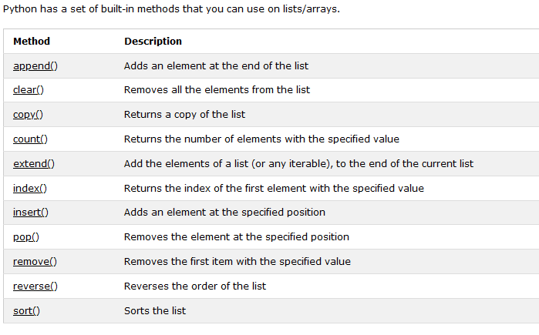
Other but not all functions in lists

Slide 7
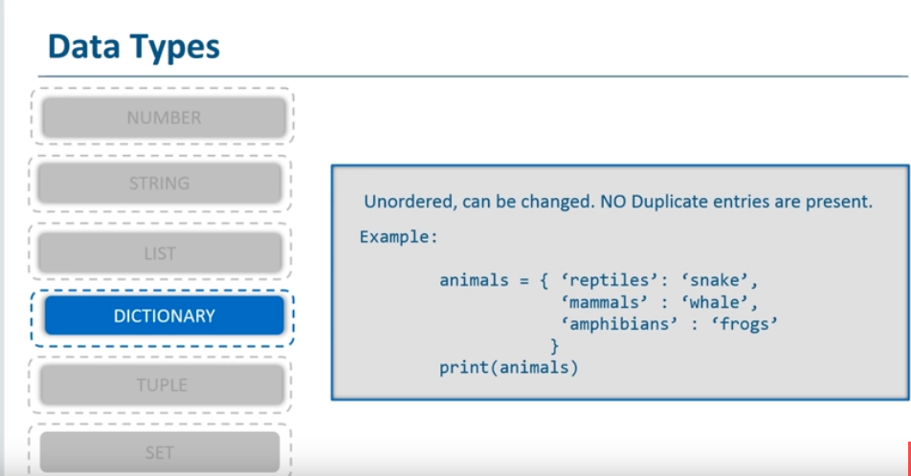

Slide 8
Dictionary
courses = {1:"python", "two": "java"}
Courses
Print using key
Courses[1]
Print using get()
Courses.get(‘two’)
Update the dictionary
Courses[1]= “C++”
Create a dictionary with 3 keys, all with the value 0:
x = ('key1', 'key2', 'key3') y = 0 thisdict = dict.fromkeys(x, y) print(thisdict)

Slide 9
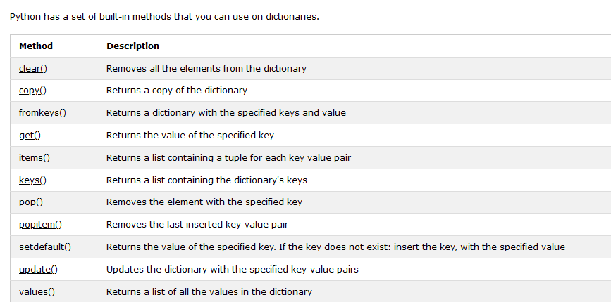

Slide 10
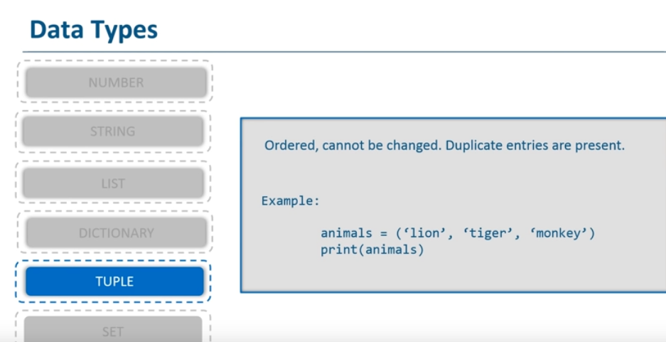

Slide 11
Create a tuple
thistuple = ("apple", "banana", "cherry") print(thistuple)
thistuple = ("apple", "banana", "cherry", "apple", "cherry") print(thistuple)
Check length
thistuple = ("apple", "banana", "cherry") print(len(thistuple))
Mixed data types
tuple1 = ("abc", 34, True, 40, "male")
Convert the tuple into a list to be able to change it:
x = ("apple", "banana", "cherry") y = list(x) y[1] = "kiwi" x = tuple(y)

Slide 12
NOTE
Tuple are unchangeable
You cannot append or pop items from it
Convert the tuple into a list, remove "an item", and convert it back into a tuple:
The del keyword can delete the tuple completely:
thistuple = ("apple", "banana", "cherry") del thistuple print(thistuple)

Slide 13
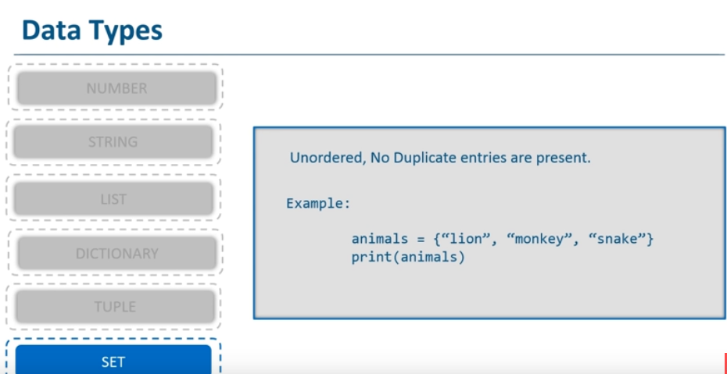

Slide 14
SET
Sets are used to store multiple items in a single variable.
A set is a collection which is both unordered and unindexed.
Sets are written with curly brackets.
Create a Set:
thisset = {"apple", "banana", "cherry"} print(thisset)
Once a set is created, you cannot change its items, but you can add new items.
Sets cannot have two items with the same value.
Get the number of items in a set:
thisset = {"apple", "banana", "cherry"} print(len(thisset))
Try creating a set with different data types

Slide 15
PYTHON OPERATORS
Operators are used to perform operations on variables and values.

Slide 16
Python divides the operators in the following groups:
Arithmetic operators
Assignment operators
Comparison operators
Logical operators
Identity operators
Membership operators
Bitwise operators

Slide 17
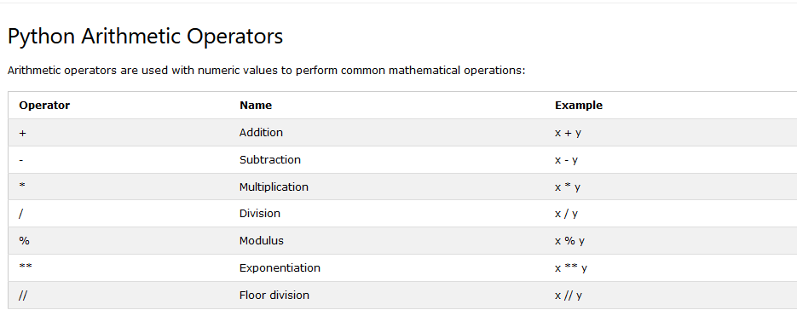

Slide 18
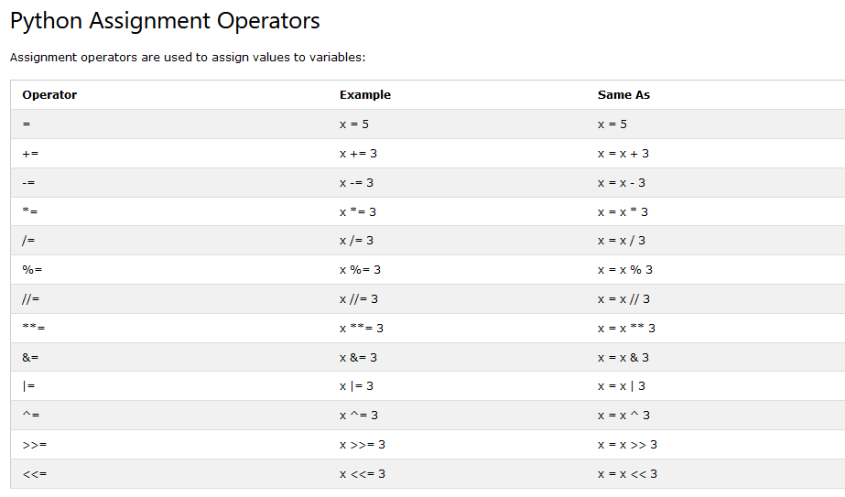

Slide 19
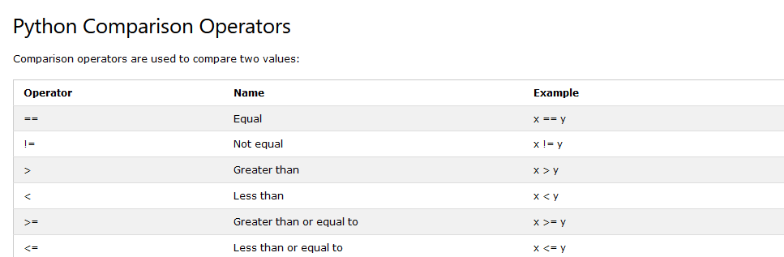

Slide 20
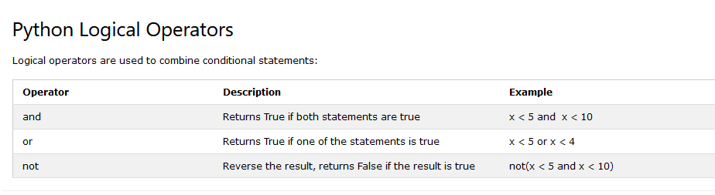

Slide 21
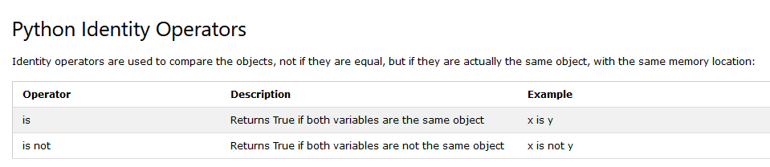

Slide 22
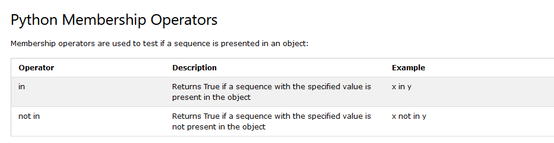

Slide 23
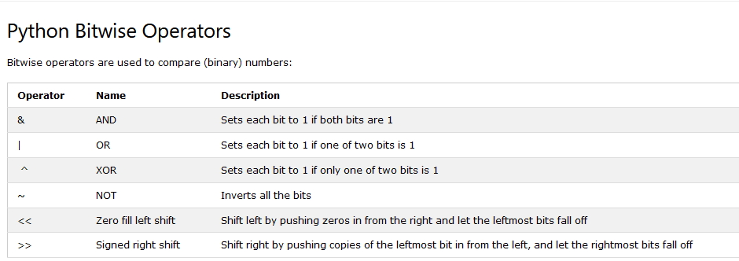

Slide 24
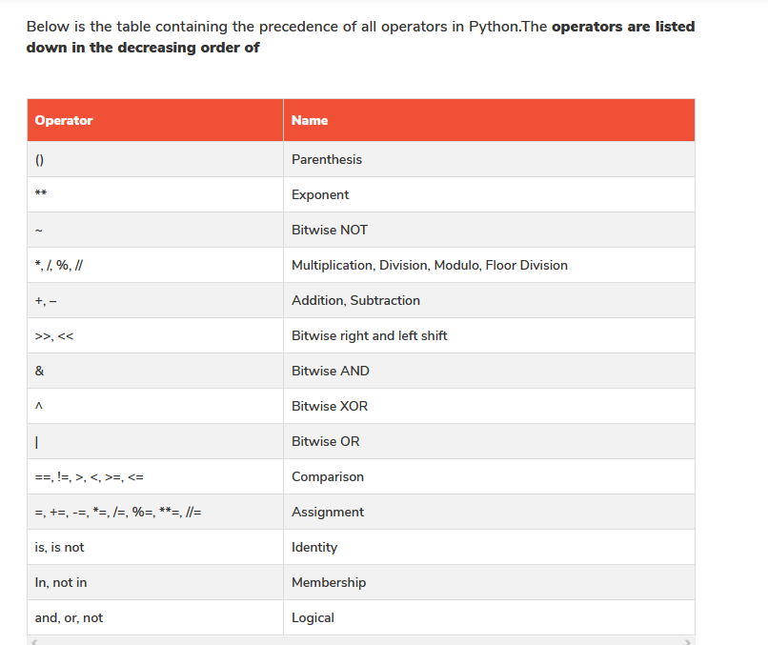
Operator precedence and associativity

Slide 25
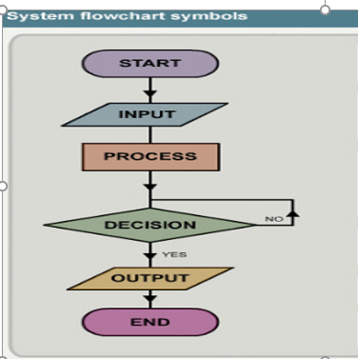
Algorithm
Step by step solution to a problem
Flowcharts
Pseudocode
Decision table
Structured charts

Slide 26
Control structures
A program’s control flow is the order in which the program’s code executes.
The control flow of a Python program is regulated by conditional statements, loops, and function calls.
Python has three types of control structures:
Sequential - default mode
Selection - used for decisions and branching
Repetition - used for looping, i.e., repeating a piece of code multiple times.

Slide 27
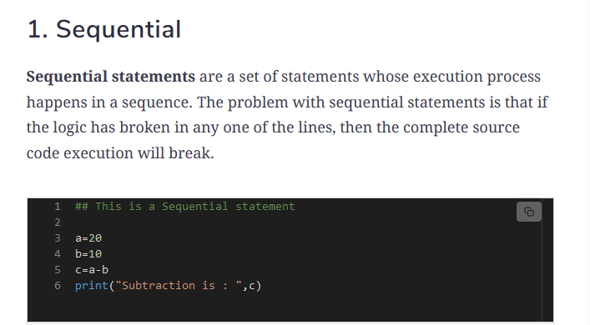

Slide 28
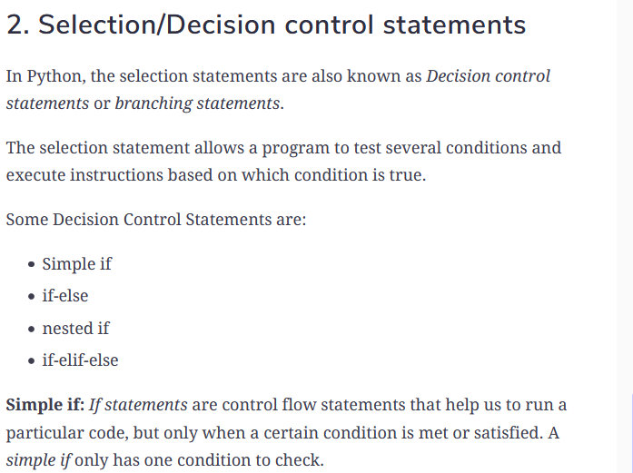

Slide 29
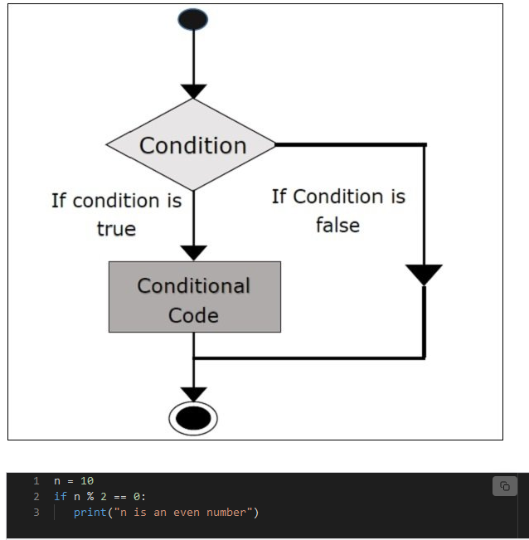

Slide 30
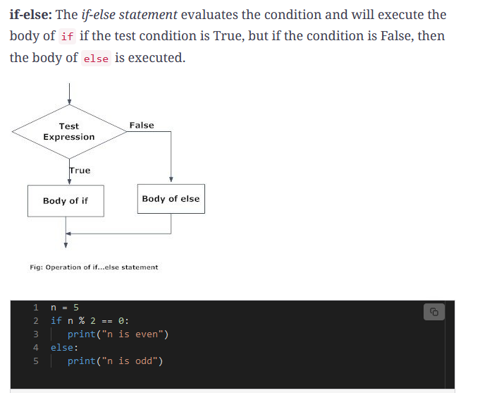

Slide 31
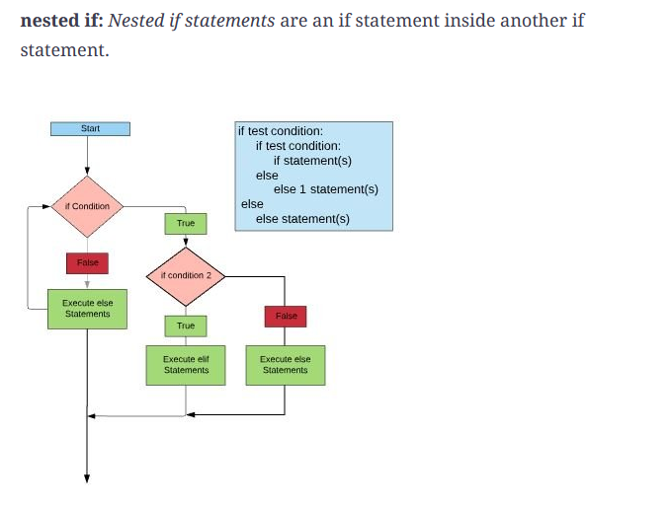

Slide 32
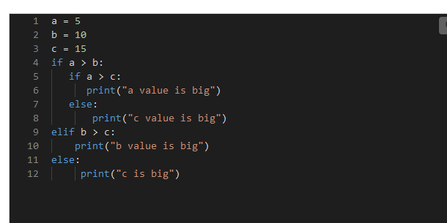

Slide 33
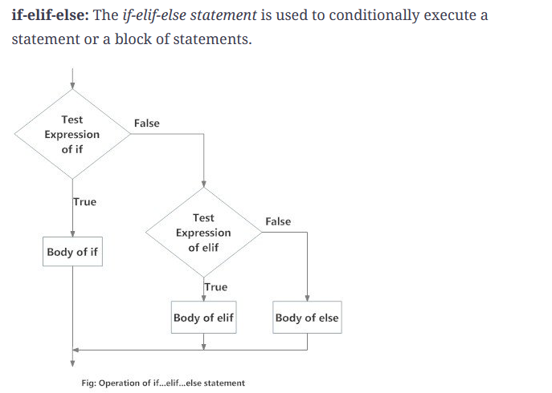

Slide 34
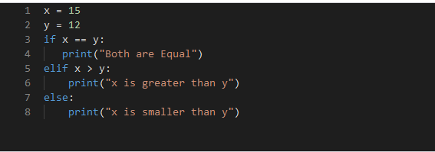
https://pynative.com/python-if-else-and-for-loop-exercise-with-solutions/

Slide 35
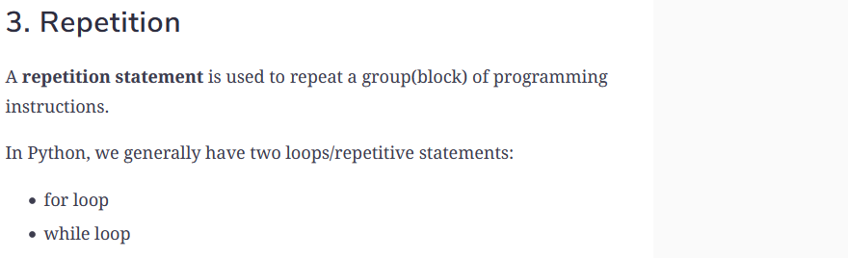
https://www.youtube.com/watch?v=OnDr4J2UXSA

Slide 36
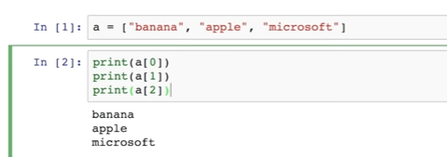
Printing individual elements in a list

Slide 37
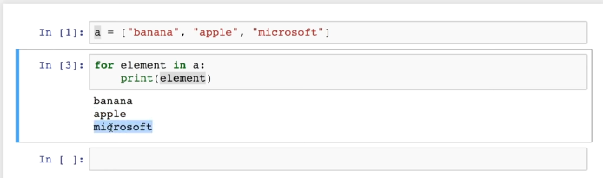
Using for loop to do the same

Slide 38
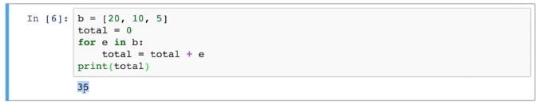
Printing the sum of the members of a list

Slide 39
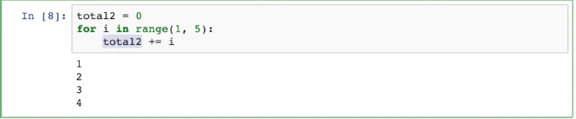


Using range method
Activity
Print the sum of numbers in the range of 1 to 20, is the number is a multiple of 3

Slide 40
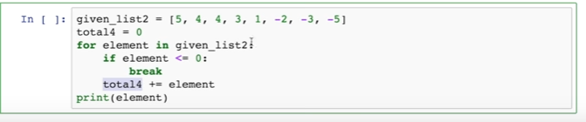
Break statement to get out of loop

Slide 41
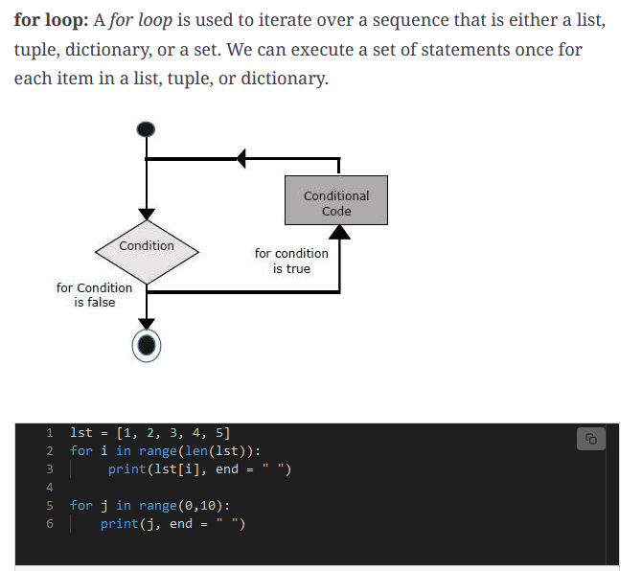

Slide 42
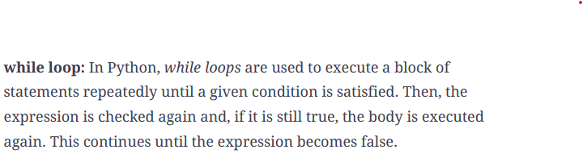

Slide 43
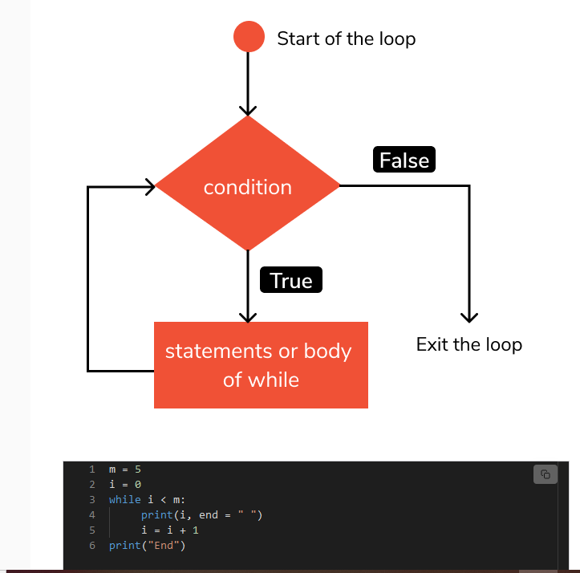

Slide 44
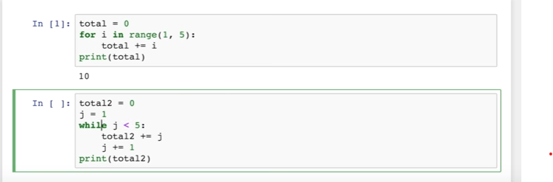
Compare while and for loop

Slide 45
1. Activity
Write a program that uses an input function to input 5 scores, calculate the total and average then use the following grading system to grade the results
Average Grade
80 – 100 A
60 – 79 B
50 – 59 C
40 – 49 D
Below Forty F

Slide 46
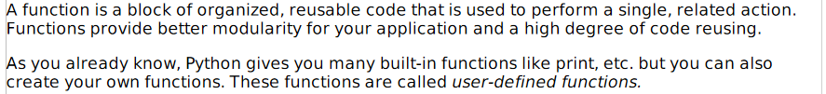
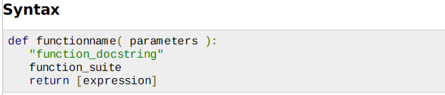
PYTHON FUNCTIONS

Slide 47
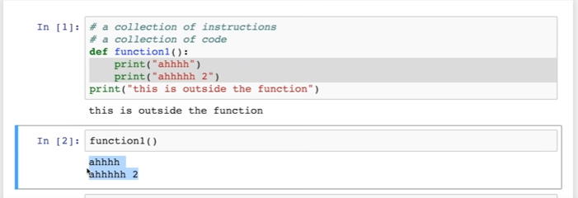
Example

Slide 48
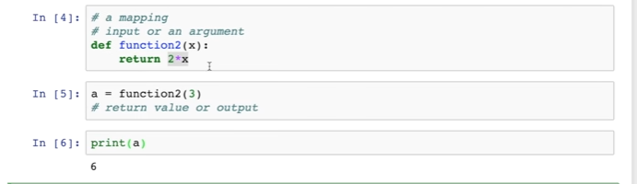
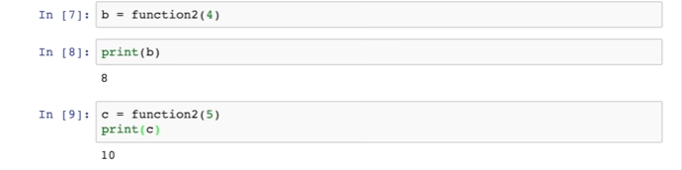
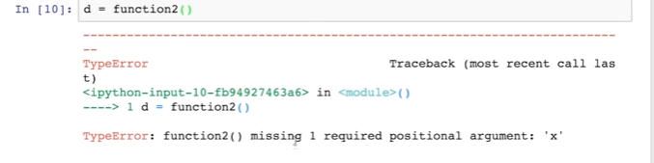

Slide 49
Activity
A function to return product two numbers
Given name of a person, height in meters, weight in kg, define a function to calculate the bmi then print 0ver weight if the bmi is more than 25 otherwise it prints good good
Define a function calculate_minutes so that given an amount of time specified in hours and minutes, the function returns the total number of minutes (e.g. given 3 hours and 15 minutes, it should return 195 minutes)

Slide 50
Activity involving selection, loops and functions
1.
Define function c such that given a list of numbers and a value n, it returns the product of the first n numbers in the list
2
Define function multiply_slice so that, given a list of numbers and two values m and n, returns the product of all numbers in the list between the mth number and nth number (e.g. multiply_slice([5, 2, 3, 4, 10], 2, 4) should return 24).

